Slide 1


Encrypted HDFS and Data Integrity on Hadoop
BIAN, Shujun – OZKAYA, Yusuf – YASAR, Abdurrahman – YU, Lei
Advisor: Dr. Ling Liu

Slide 2
Outline
Introduction to Hadoop
Motivation
HDFS
Encryption
De-anonymization attack
Shuffling
RDMA Based Shuffling
Encryption of RDMA
Data Integrity
PDP on untrusted cloud
Bad Mapper-Reducer detection
Future Work
Conclusion

Slide 3
[SHUJUN]
INTRODUCTION TO HADOOP

Slide 4
Overview of MapReduce and Hadoop
What is Hadoop
Open-source software framework
Written in Java
Runs on
Linux, Mac OS/X, Windows and Solaris
Commodity Hardware
Core of Hadoop
Distributed File System
MapReduce
Why Hadoop
Data! Lots of Data!

Slide 5
Overview of MapReduce and Hadoop
What is MapReduce
A simple programming model that applies to many large-scale computing problems
Gain efficiency from streaming the data, reducing the seeks, pipelining
Why MapReduce
Java, C++, and test-based APIs
Automatic re-execution on failure
Localization optimization

Slide 6
Overview of MapReduce and Hadoop
Logical Overview
Defined with data structured in (key, value) pairs
Input: a set of key/value pairs
User only supplies two functions:
Map(k1,v1) → list(k2,v2)
Reduce(k2, list (v2)) → list(v3)
(k2,v2) is an intermediate key/value pair
Output is the set of (k2,v3) pairs
Thus the MapReduce framework transforms a list of (key, value) pairs into a list of values.

Slide 7
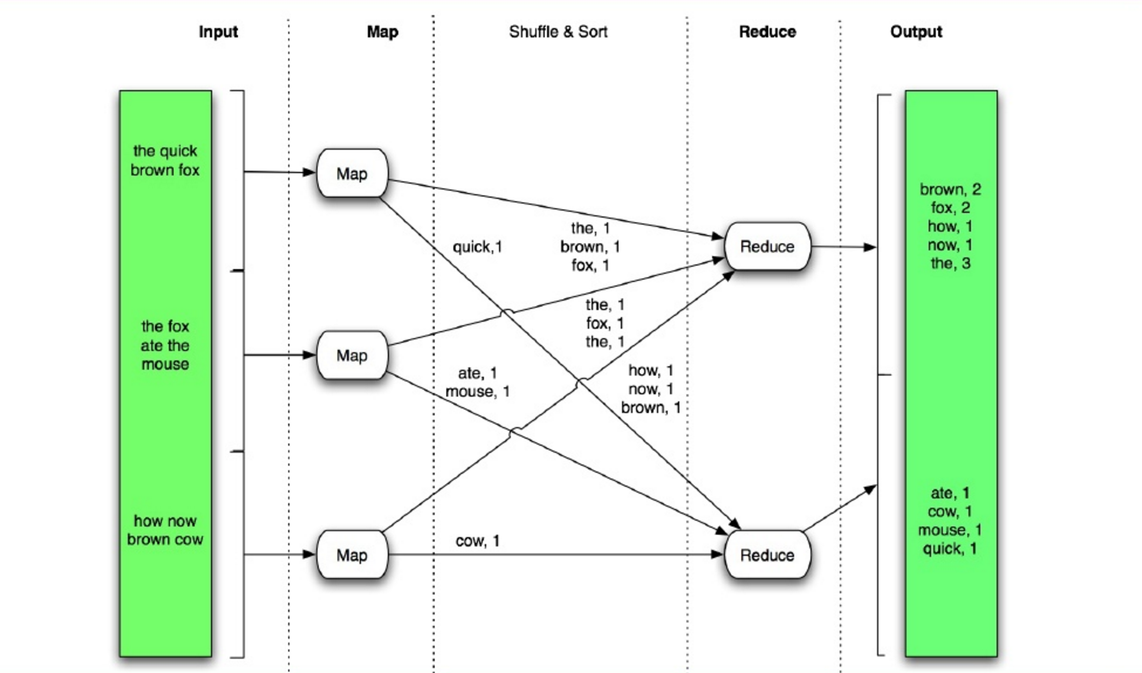
Overview of MapReduce and Hadoop

Slide 8
MOTIVATION

Slide 9






They are Using Hadoop
They are Using Hadoop

Slide 10
Security on Hadoop: Current State
Kerberos credentials:
Instead of creating user accounts for each hadoop user use existing user accounts of the hosting organization.
Kerberos signon: login is supplemented by kerberos
Users, groups, supergroups
There is no superuser notion
HDFS offers Unix-like permission: owner group and other
Authentication : Kerberos over ssl
Better performance, simpler user management

Slide 11
Still Exist Some Threats
Unauthorized access to HDFS: via HTTP or RPC
Unauthorized read/write a data block of a file at Data Node: pipeline streaming data transfer protocol
Unauthorized user may submit a job to a queue or delete or change priority of the job
Unauthorized client may access intermediate data of Map job via its task trackers HTTP shuffle protocol.
Executing task may use the host operating system interfaces to access other tasks.

Slide 12

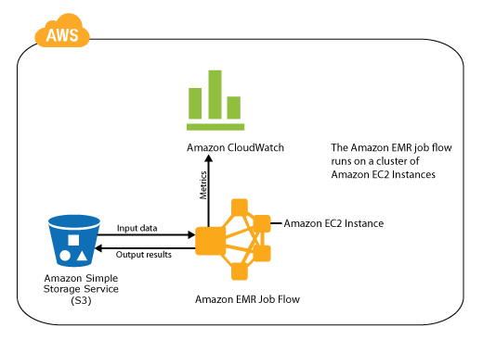
Security issues on Cloud
Cloud providers provides shared cloud infrastructure for storing and processing large datasets

Slide 13
Security issues on Cloud
Cloud providers provides shared cloud infrastructure for storing and processing large datasets
Users have to trust the cloud provider with their code and data!

Slide 14
Security issues on Cloud
Threats:
Malicious insider with administrator privileges in the cloud provider’s organization
Dishonest cloud provider could tamper with the execution of user’s code (for example, simply not run the user’s code to completion in order to save on resources).
External attackers may attempt to access users’ data, e. g., by exploiting vulnerabilities in an operating system or even a hypervisor deployed in the cloud infrastructure

Slide 15
[YUSUF]
HDFS ENCRYPTION

Slide 16
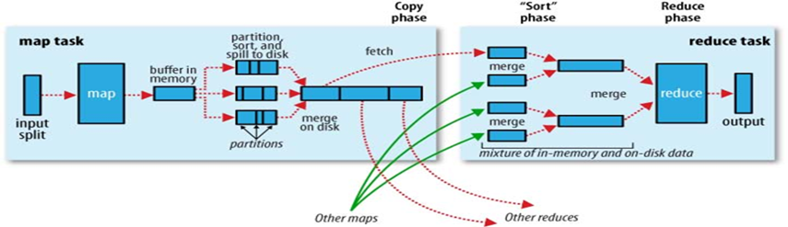
Passive Inference Attacks - MiTM
A passive adversary with access to data flow can infer a lot of things. (Man-in-the-Middle)
Assuming access to only JobTracker, the attacker can match data in batch files and results of application.
HOW?

Slide 17
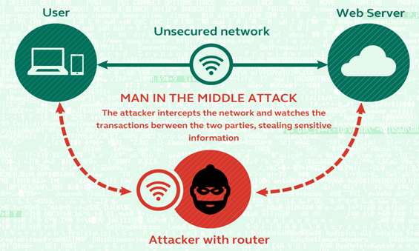
The shuffle phase occurs over a network, the network traffic is susceptible to malicious attacks such as Man-in-the-Middle attack or eavesdropping.

Slide 18
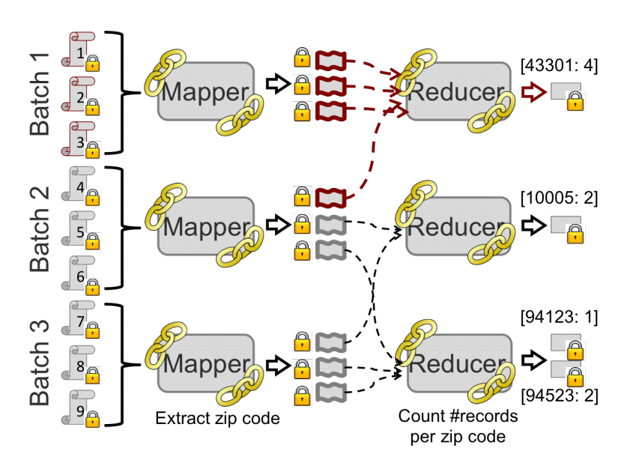
Passive Inference Attacks
Assume there are 3 Batch files for 3 mappers; and 9 spill files.
Since an adversary observes input and output of every mapper and reducer, He can easily construct a matrix.

Slide 19
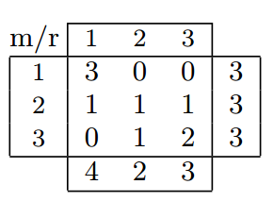
Passive Inference Attacks
And Generate this matrix:
A[m, r] is the number of intermediate key-value pairs sent from mapper m to reducer r.

Slide 20
Passive Inference Attacks
Adversary sees that the first three records have the same zip code (43301);
And the last three records do not have this zip code.
If the adversary has some background knowledge of the distribution of zip codes,
He can label the columns of A with zip codes.
This information can be inferred even when the data is encrypted.
Notes:
Every Mapper reads three encrypted records, extracts a zip code and each Reducer counts the number of records per zip code. In the matrix, each entry A[m, r] indicates how many intermediate key-value pairs produced by the mth mapper have zip code that was returned by the rth reducer. In particular, the adversary sees that the first three records have the same zip code (43301) and the last three records do not have this zip code. Given background knowledge of the distribution of zip codes, the adversary can thus, in this case, label each column of A with a zip code. Abusing our notation, we refer to the cell A[1, 1] as A[1, '433011'].

Slide 21
Passive Inference Attacks
Replace the zip codes with valuable information of different industries: Health Industry
HIV
Flu
AIDS
Notes:
Every Mapper reads three encrypted records, extracts a zip code and each Reducer counts the number of records per zip code. In the matrix, each entry A[m, r] indicates how many intermediate key-value pairs produced by the mth mapper have zip code that was returned by the rth reducer. In particular, the adversary sees that the first three records have the same zip code (43301) and the last three records do not have this zip code. Given background knowledge of the distribution of zip codes, the adversary can thus, in this case, label each column of A with a zip code. Abusing our notation, we refer to the cell A[1, 1] as A[1, '433011'].

Slide 22
[LEI & SHUJUN]
RDMA & ENCRYPTED SHUFFLING

Slide 23
Overview of RDMA
What is RDMA
Open-source software framework
Written in Java
Runs on
Linux, Mac OS/X, Windows and Solaris
Commodity Hardware
Core of Hadoop
Distributed File System
MapReduce
Why Hadoop
Data! Lots of Data!

Slide 24
[ABDURRAHMAN]
DATA INTEGRITY

Slide 25
Why Data Possession?
Storing data at remote, untrusted source can cause problems
Examples of untrusted sources include library archives that are not well maintained
Data losses are common during system migration or maintenance
Server might misbehave and remove parts of data that are unused or rarely accessed to save space
Even worse, server will convince you that there is no data loss

Slide 26
Client only have to query for only a constant number of blocks to detect server anomalies. The number is independent of number of blocks in the server

Slide 27
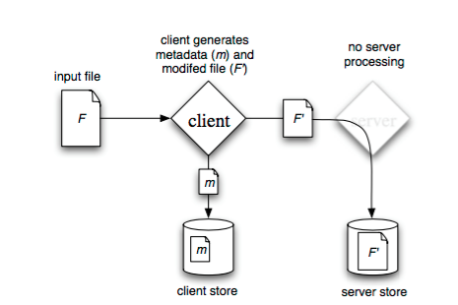
Pre-process and Store

Slide 28
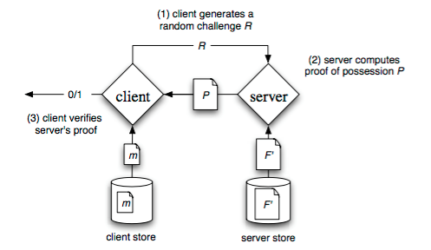
Verify Server Possession

Slide 29
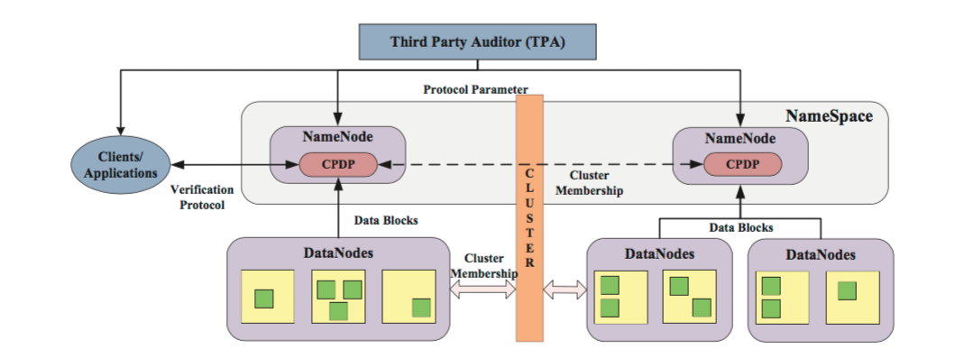
Integrating PDP with hadoop

Slide 30
FUTURE WORK

Slide 31
[ABDURRAHMAN]
CONCLUSION

Slide 32

QUESTIONS?

